Slide 1

Plan a quantitative investigation Andrew Chapman SAS Coordinator

Slide 2
Planning Stages
Create a quantitative form of the research question.
Plan the analyss, number of observations, and the data collection method.
Collect, clean andprepare the data.
Perform and validate the statistical analysis.

Slide 3

Planning
Create a quantitative form of the research question.
Plan the analysis, number of observations, and the data collection method.
Collect, clean and prepare the data.
Perform and validate the statistical analysis.

Slide 4
A Quantitative Investigation
Create a quantitative form of the research question.
Plan the analysis, number of observations, and the data collection method.
Collect, clean and prepare the data.
Perform and validate the statistical analysis.

Slide 5
Create a quantitative form of the Research Question Andrew Chapman SAS Coordinator

Slide 6
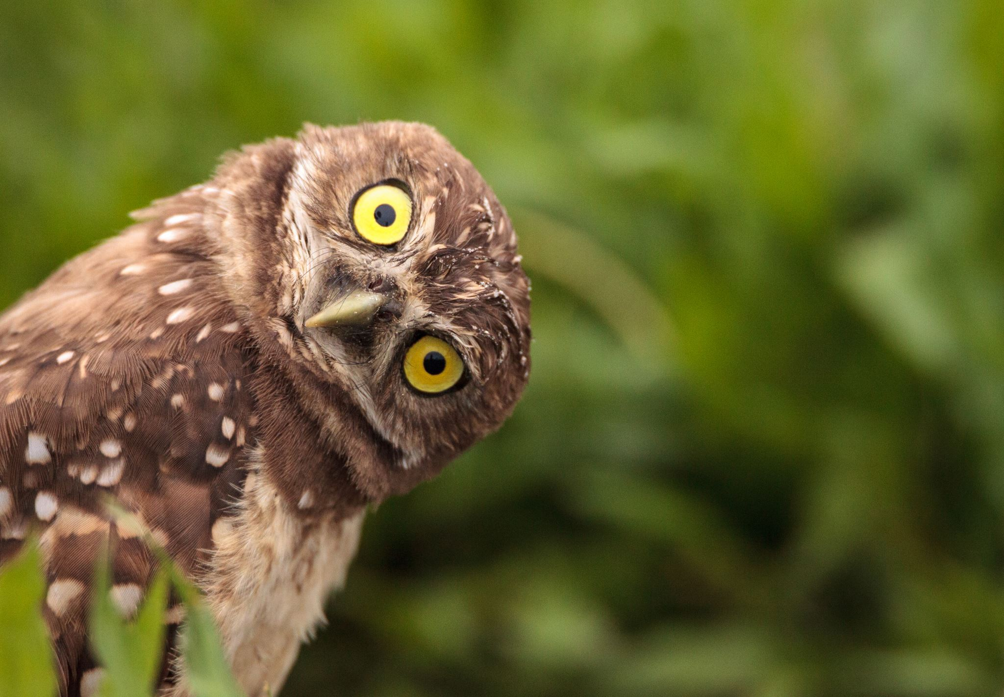
Research Questions (RQs) !?

Slide 7
Numbers: Counting, Measuring !?
List all the nouns and adjectives mentioned in the RQs and consider each one as an object “Variable” to be measured or categorised.
Consider the adjectives and verbs in the RQs and how each one helps to define the relationship to be tested.
Identify all the items or subjects for whom we could measure the variables and relationships when answering the research question: call them the ”Population”.

Slide 8
Example RQ1
Are consumers prepared to pay more money for more carbon-efficient dairy-products?
Variables:
Consumers, money, dairy-product; more, carbon-efficient.
Relationships:
Money ~ Carbon-efficiency
Population:
Supermarket Shoppers in UK.

Slide 9
Example RQ2
Which type of intervention gives the largest increase in Y5 children’s moderate-to-vigorous activity per school-day.
Variables:
Intervention-type, Increase, Y5 Children, Moderate-to-Vigorous activity, School-day; largest.
Relationships:
Increase ~ Type
Population:
Junior-School children in one school in Bath.

Slide 10
RQs: helpful resources
Here’s a useful 15 minute video “How to Write a Well-stated RQ” https://www.youtube.com/watch?v=kwwdHkYPNo4.
Another excellent video with detailed and practical guidance
including lots of examples (especially in the last 7 minutes) at https://www.youtube.com/watch?v=pnwnZzv1RGY.
A useful article
“Formulation of Research Question – Stepwise Approach” at https://www.ncbi.nlm.nih.gov/pmc/articles/PMC6322175/

Slide 11



Measuring Variables?

Slide 12
Variables measured?
Using a survey?
Use questions from the literature which have been validated in a similar population.
Using Experiments?
Use measurement equipment and methods established in the literature.
Heartily recommend the Research Data Management Adventure https://rdm-games.gitlab.io/rdm-adventure/
Using new variables with measurement methods which need to be validated?
Be aware that validation is a major task.

Slide 13

Surveys: helpful resources
"Selecting, Designing and Developing your questionnaire"
is a short article to be found via: https://www.ncbi.nlm.nih.gov/pmc/articles/PMC420179/.
Questionnaires, Scales and survey questions used in influential papers from your literature search.

Slide 14
Surveys: validated questions
UK dataservice question bank.
https://www.rand.org/health-care/surveys_tools.html
http://www.healthmeasures.net/explore-measurement-systems/promis
PROMIS has had a substantial impact, with approximately 70 domains measuring pain, fatigue, depression, anxiety, sleep disturbance, physical function, social function, and sexual function, among other areas.
http://www.ihsn.org/sites/default/files/resources/Global%20RefList%20Core%20Indicators%20V4_3Oct2014.pdf
The Global Reference List of Core Health Indicators: each indicator belongs to one of four domains: health status, risk factors, service coverage and health systems.
http://survmeth.blogspot.com/2015/01/sources-for-survey-questions-and.html

Slide 15

Experimental Design?
Does the experimental design include some randomisation to eliminate uncontrolled factors?
Are variables measured several times for each subject?
Do the number of measurements and number of subjects provide an adequate sample size for statistical analysis?

Slide 16
Experiment Design: resources
https://nc3rs.org.uk/ for advice and guidelines when animals are involved.
https://www.coursera.org/learn/experimentation/home/welcome is a lively, free online course from McMaster University.
https://www.moresteam.com/toolbox/design-of-experiments.cfm is a tutorial.
“Design and Analysis of Experiments” is a textbook in its 5th edition by D.C. Montgomery.
https://scidesign.github.io/designbook/introduction.html is a comprehensive online book.

Slide 17
New Measurement Methods
Validating new Measurement Methods is a major task:
An introduction to this topic can be found in the classic reference “Questionnaire Design, Interviewing and Attitude Measurement” by A.N.Oppenheim:
see chapter 9.
“Measurement in Medicine – a practical guide” by H.C.W. de Vet is an excellent, recent book:
See chapter 6.

Slide 18

Types of Variable
Analysis methods will depend on the Types of Variables:
Binary
Category
Ordinal
Continuous

Slide 19
Examples of Variable Types:
Binary
yes/no, control/treatment, 1/0, success/failure.
Category
Group, Class, Type, Colour, Variant, Region, Area.
Ordinal
Ranking, Likert-Scale, Number of Children, Age-Group.
Continuous
Height, Age, Time, Anxiety as an average-of-Likert-scales.

Slide 20

Picture your Results

Slide 21
Visualise your RQ
How would the RQ relationships be shown and made clear
In a chart or graph?
In a table?
Find some good examples from your literature search.

Slide 22
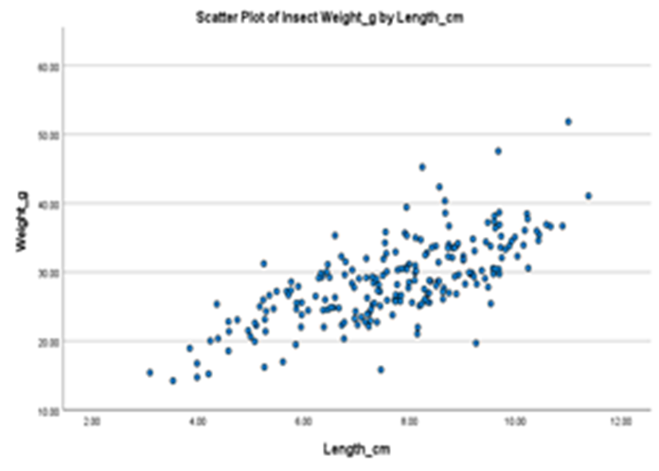
Charting an RQ
Scatter-plot for relationship between continuous variables

Slide 23
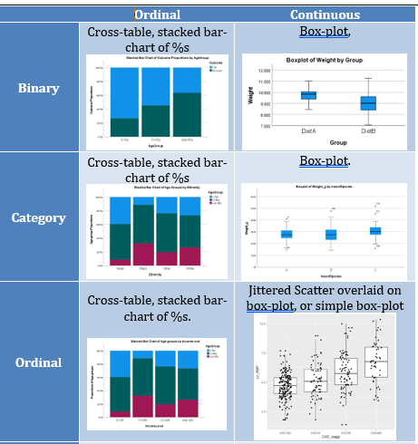
Charts for Categories

Slide 24
Charts for Numbers

Slide 25
a quantitative form of the Research Question Andrew Chapman SAS Coordinator

